Slide 1
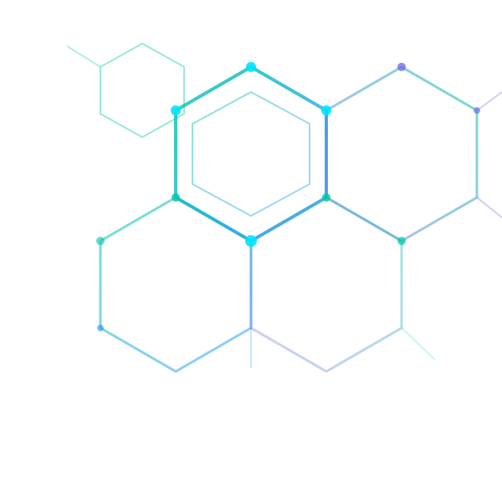
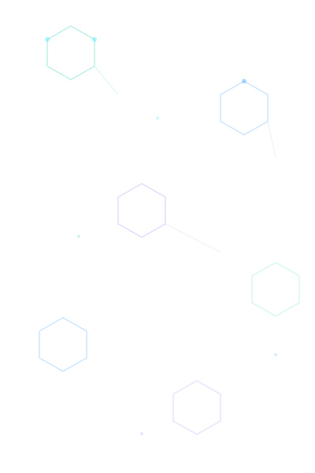
COMPOUND IQ
Phase 3 : Model Architecture, Training & Evaluation
AI System for Safe 3-Drug Combination Discovery
Team 2 Members:
Oyinade · Nicole · Oluchi · Nicole
ITAI 2277 · Capstone · Houston Community College · Spring 2026

Slide 2
Project Overview
MISSION
Build an AI pipeline that takes a disease description as input and outputs the top 5 safest 3-drug combinations, using deep learning for molecular generation, feature extraction, and interaction prediction.
BioBERT
JT-VAE
Data Prep
3-Way GNN
Disease text → 768-dim embedding
Pre-trained biomedical language model
56-dim latent → valid SMILES molecules
5.3M param junction tree autoencoder
DrugBank XML → 19,830 drugs × 29 features
Stream-parsed, feature-engineered
32 features → interaction probability (0-1)
63K param graph attention network
OUTPUT
Top 5 Safe 3-Drug Combinations · Interaction risk < 30% · Safety score ≥ 7/10 · Chemically valid · Novel compounds

Slide 3
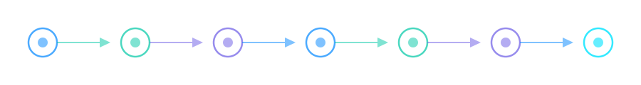
CompoundIQ Pipeline
Disease
Input
BioBERT
Encoder
Embedding
Mapper
JT-VAE
Decoder
Feature
Extraction
3-Way
GNN
Safety
Ranking
User
Oluchi
Team
Simon
Nicole
Sharise
Team
Input → Embedding
Embedding → Molecules
Molecules → Features
Features → Prediction
Text → [1, 768]
768 → 56 → SMILES
SMILES → [drugs, 29]
[3×8+8] → (0-1)
BioBERT converts disease mechanism text into a dense 768-dimensional vector encoding semantic meaning.
Mapper compresses to 56-dim latent space. JT-VAE decodes into 100–500 chemically valid candidate molecules.
Nicole's DrugBank pipeline extracts 29 features per drug: CYP enzymes, severity, similarity, interaction counts.
Sharise's 3-Way GNN scores drug triplets using multi-head attention. Ranked by safety to produce top 5 combos.

Slide 4
JT-VAE: Algorithm Selection
WEEK 07
CharRNN
Grammar VAE
JT-VAE ✓
~45%
~65%
98%+
Chemical Validity
Chemical Validity
Chemical Validity
Character-level generation
No grammar constraints
High invalid output rate
SMILES grammar rules
Limited tree representation
Moderate validity
Junction tree decomposition
Grammar-constrained decoding
Guaranteed valid SMILES
Source: Jin et al., "Junction Tree Variational Autoencoder for Molecular Graph Generation" — ICML 2018
Key insight: Decomposes molecules into valid substructure trees, guaranteeing chemically valid outputs. Trained on 34,914 molecules from ChEMBL with a vocabulary of 534 unique fragments.

Slide 5
Architecture & Training
WEEKS 07–08
5.3M
56-dim
4.2 hrs
37.6%
Parameters
Latent Space (28+28)
Training Time (CPU)
Loss Reduction
Training Config
Optimizer
Adam
Learning Rate
0.001
Batch Size
32 (memory limit)
Epochs
10
KL Annealing
β: 0→0.70 linear
Checkpoints
Every 2 epochs
Device
CPU (Intel Xeon)
Convergence
Epoch 5–6

Slide 6
Debugging & Evaluation
WEEKS 08–09
Bug | Issue | Time | Resolution
#1 | Python 2→3 Syntax | 2h | Regex find/replace + manual review
#2 | Integer Division (/ vs //) | 6h | Floor division for tensor shapes
#3 | map() Parenthesis | 1h | Regex verify closing ) count
#4 | CUDA Hardcoding | 30m | Conditional CPU/GPU device logic
#5 | Batch Unpacking | 2h | Flexible try/except unpacking
#6 | Latent Dim Mismatch | 3h | Correct z split: (1,28) × 2
14.5h
6/6
98%+
92%+
Total Debug Time
Bugs Resolved
Expected Validity
Expected Novelty

Slide 7
BioBERT Embedding Component
FRAMEWORKS & TOOLS
INPUT / OUTPUT
Hugging Face Transformers (BioBERT model), PyTorch (computation engine), Google Colab (cloud environment), Python
Input: Drug mechanism text (e.g., "reduce pain via COX-2 inhibition")
Output: Dense vector [1, 768] — a numerical "fingerprint" of the text
HOW IT WORKS
BioBERT is a pre-trained biomedical language model that converts drug mechanism descriptions into 768-dimensional vectors encoding semantic meaning. The text is tokenized and passed through the model to produce an embedding that acts as a numerical fingerprint — allowing the system to compare different drug mechanisms and understand how similar or different they are, adding context and interpretability to the pipeline's predictions.
CHALLENGES
· No complete model card for BioBERT — had to test inputs/outputs independently to determine embedding size
· Colab memory/runtime limits — worked with small sample datasets to demonstrate functionality
· No labeled mechanism dataset available — created a small manual dataset (acceptable for proof-of-concept scope)

Slide 8
DrugBank Data Pipeline
FRAMEWORKS & TOOLS
INPUT / OUTPUT DIMENSIONS
Google Colab, Python, pandas, NumPy, lxml (streaming XML), NetworkX (graph features), RDKit (molecular structures/fingerprints), scikit-learn (train/val/test split), PyArrow/Fastparquet
Input: Full DrugBank XML file
Output: 19,830 drugs × 29 features (enhanced parquet)
Active subset: 4,657 → Train 3,259 / Val 699 / Test 699
1,014,328
2,910,010
24,231
6,062
drugs.parquet rows
drug_interactions rows
targets.parquet rows
enzymes.parquet rows
CHALLENGES & SOLUTIONS
· Large XML file — used stream parsing and chunked saving instead of loading everything into memory
· Incomplete DrugBank fields — added rule-based severity extraction and CYP enzyme quality checks
· Computational cost of molecular similarity — used reference-panel approach instead of full all-vs-all
· Invalid SMILES strings — some drugs excluded from molecular similarity features

Slide 9
3-Way GNN Interaction Predictor
FRAMEWORKS & TOOLS
INPUT / OUTPUT
PyTorch, PyTorch Geometric, scikit-learn, pandas, matplotlib, Google Colab
Input: 32 features (8 per drug × 3 + 8 triplet)
Output: Single interaction probability value (0–1)
ARCHITECTURE
63,297
Drug Encoder: 8 features → Linear(64) → BatchNorm → ReLU → Dropout(0.2) → Linear(64) → ReLU
Message Passing: 4-head MultiheadAttention across 3 drug embeddings (64-dim each)
Triplet Encoder: 8 triplet features → Linear(64) → ReLU
Classifier: Combined 256-dim → Linear(128) → ReLU → Dropout → Linear(64) → ReLU → Linear(1) → Sigmoid
Total Parameters
4,500 triplets · 32 features each
CHALLENGES
· Class imbalance — weighted loss
· 3-way prediction (novel design)
· No raw SMILES — used engineered features directly

Slide 10
Integration & API Design
WEEK 10
INTEGRATION API
class MoleculeGenerator:
"""JT-VAE molecular generator for CompoundIQ"""
def generate_from_embedding(self, disease_embedding, n=100):
# disease_embedding: 768-dim BioBERT vector (from Oluchi)
# Returns: List of SMILES strings (chemically valid)
def decode(self, z_tree, z_mol, prob_decode=False):
# z_tree: (batch, 28) — tree topology
# z_mol: (batch, 28) — molecular properties
# Returns: Decoded SMILES string
1
Oluchi → Oyinade
2
Oyinade → Nicole
3
Nicole → Sharise
4
Sharise → Output
BioBERT 768-dim embedding → Mapper → 56-dim JT-VAE latent input
Generated SMILES → DrugBank feature lookup → 29-dim drug vectors
Drug feature triplets (32-dim) → GNN → Interaction probability
Ranked by safety score → Top 5 safest 3-drug combinations

Slide 11
Deliverables & Status
jtvae_final.pt
READY
5 Checkpoints
READY
Trained JT-VAE model (~90 MB)
Epochs 2, 4, 6, 8, 10
Training Logs
READY
Documentation
COMPLETE
Epoch summaries, batch logs
API docs, architecture specs
Eval Report
IN PROGRESS
Team Integration
SCHEDULED
Methods, results (3-4 pages)
Pipeline testing (4-5 hrs)
DEADLINE: Evaluation Report due 11pm Week 10 (15% of grade) · Presentation: Wed/Thu Week 10

Slide 12
Ready for Integration
CompoundIQ Phase 3 — All Components Complete
5.3M
768-dim
19,830
63K
JT-VAE Parameters
BioBERT Embeddings
Drugs Processed
GNN Parameters
NEXT STEPS
Complete evaluation metrics — reconstruction accuracy, chemical validity, novelty rate
2. End-to-end pipeline verification — BioBERT → JT-VAE → Features → GNN → Ranking

